Slide 1
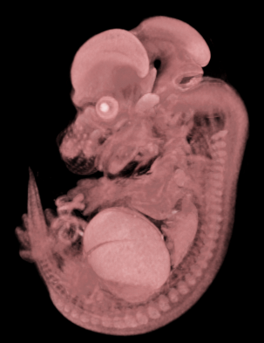
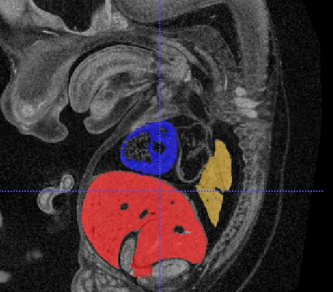
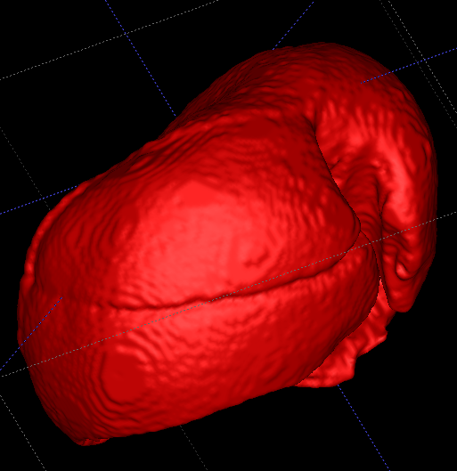
SIAH: 7th Feb 2013 Group Meeting
Semi-Automated Segmentation Update: How can we deal with problematic regions?

Slide 2
SIAH: Systems Imaging at Harwell What we do
Develop the Embryonic Lethal Pipeline
Procedure development, validation, QC, annotation, and display (portal)
Support NIH secondary phenotyping grants
Later in 2014
Support Image Processing at Harwell
3D help Sara, James, Michael (new starter), Dom, and others
OPT, MicroCT, MRI, SlideScanner, 2D images data types
Respond to requests for external collaboration
Number of projects currently ongoing (aortas, vascularisation), expecting more
Confluence page: http://confluence.mrch.har.mrc.ac.uk/display/EP/Imaging

Slide 3
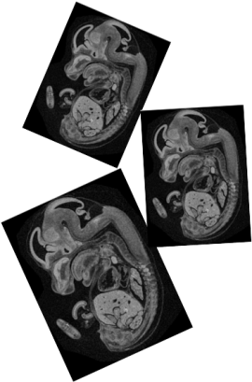
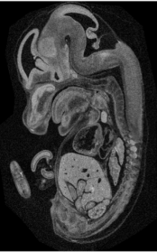
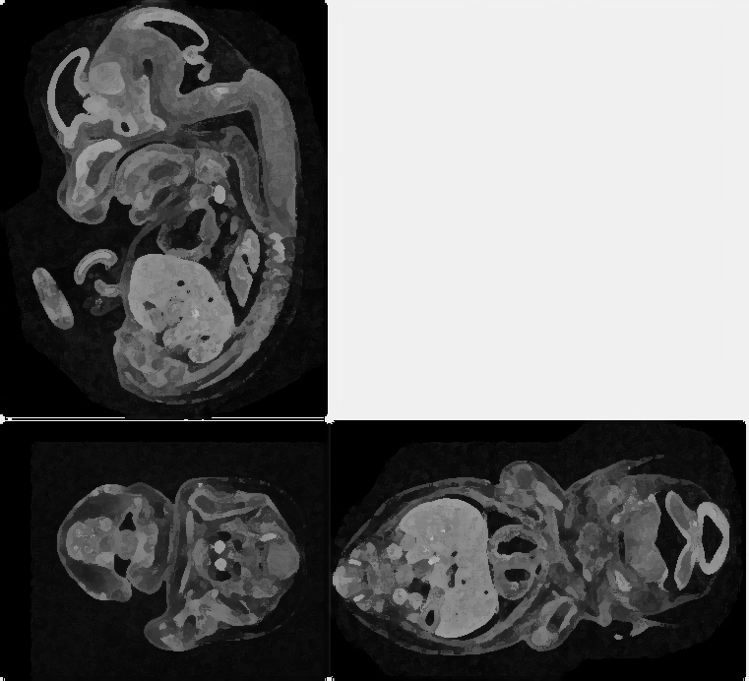

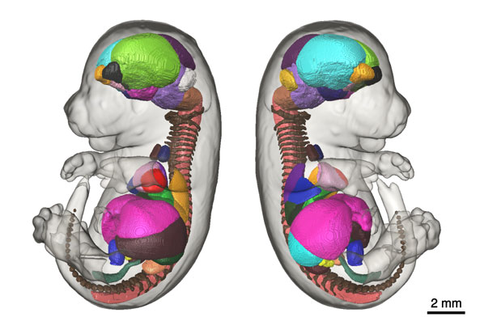


Automated Annotation Imaging Pipeline
Image Collection
Registration
Segmentation
Atlas Creation
Annotation
Scan embryos of the same age
Register the embryos together
Create an average embryo
Segment the average embryo
Fully annotated Atlas created from segmentation
Register new embryos to atlas for automatic annotation

Slide 4
Semi-automated Segmentation
What is segmentation?
The separation of an image into two or more parts. When applied to medical images this can mean separating an image into biological components such as organs.
What is Semi-automated segmentation?
Segmentation using computer algorithms and some form of user input.
Fully automated segmentation not currently achievable
Advantages of semi-automated Vs manual?
Save time
Reduce human error
Reduce interpersonal variation

Slide 5
Segmentation methods
Manual Segmentation
Semi-automated segmentation
Amplitude segmentation
Edge based segmentation
Region based segmentation
Texture based segmentation
Atlas based segmentation

Slide 6
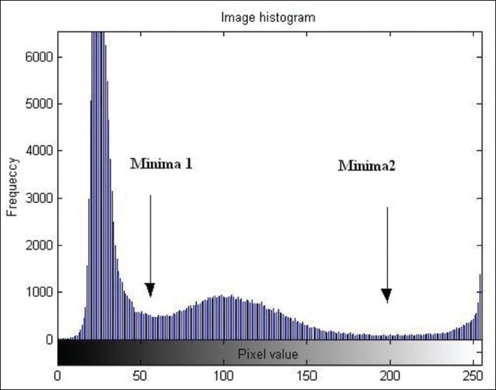
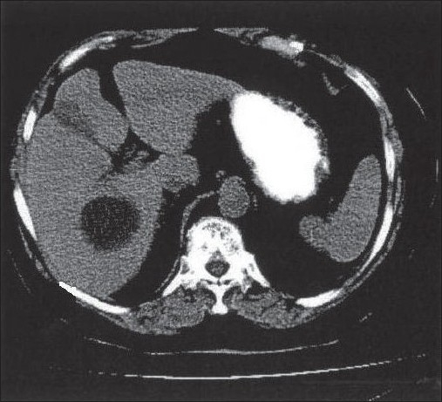
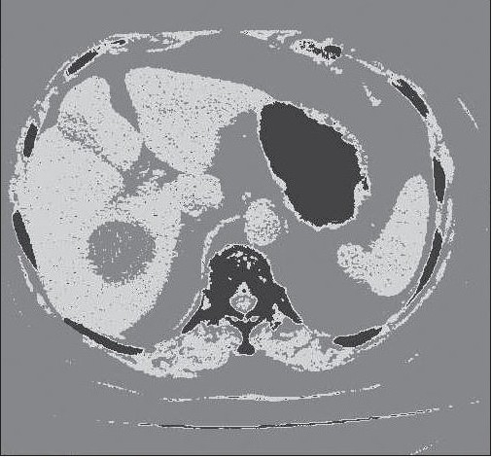
Amplitude segmentation
The histogram of the image can be used to determine thresholds for segmentation
Considered simplest of segmentation methods
Histogram of image. The minima are used as thresholds
Original image of abdomen slice
Segmented image into three components
Images taken from: Sharma, N., and Lalit M. Aggarwal. (2010). "Automated medical image segmentation techniques." Journal of medical physics/Association of Medical Physicists of India 35.1.
Notes:
“Object 1 belongs (0 to 55)
Object 2 belongs (55 to 200)
Object 3 belongs (200 to 255)
For histogram-based optimal segmentation of images numbers of methods have been proposed by different researchers.[11,15–17] Frank et al,[17] have used optimal threshold selection method for segmentation of T1 weighted MR brain image to segment gray matter, white matter, and cerebro spinal fluid.”
“Selection of proper values of threshold is quite difficult. Performance is affected in presence of artifacts.”
Quotes taken from: Sharma, N., and Lalit M. Aggarwal. (2010). "Automated medical image segmentation techniques." Journal of medical physics/Association of Medical Physicists of India 35.1.

Slide 7
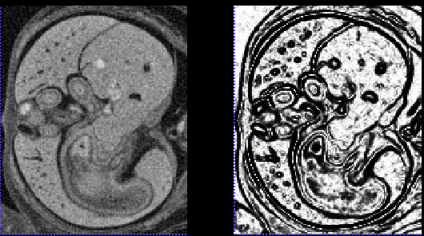
Edge based segmentation
An image is divided based on boundaries determined by differences in grey level or colour.
Variety of edge detection algorithms but generally the method includes:
Smoothing the image
Detect edges based on change between grey values (gradient)
Use a threshold to remove weak edges
Original image (E14.5 Abdomen Harwell)
Edge pre-processed with ITK-SNAP

Slide 8
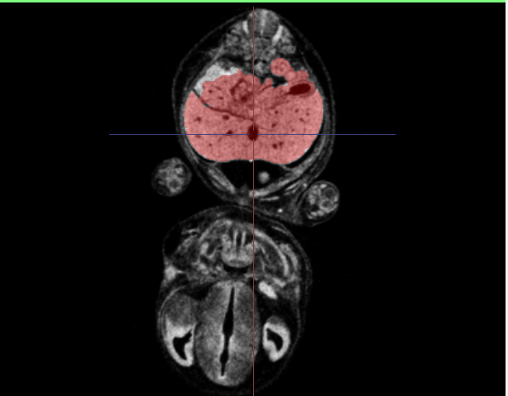
Region based segmentation
Based on clustering of pixels with similar properties, i.e. the pixels have homogenous grey level.
There are various region growing methods including seeded region growing.
A set of seeds are taken from the image identifying homogenous regions to be segmented
The regions then grow depending on the neighbouring pixel intensity and the mean of the region
Region growing segmentation using GIMIAS tool for E14.5 Abdomen (Harwell)

Slide 9
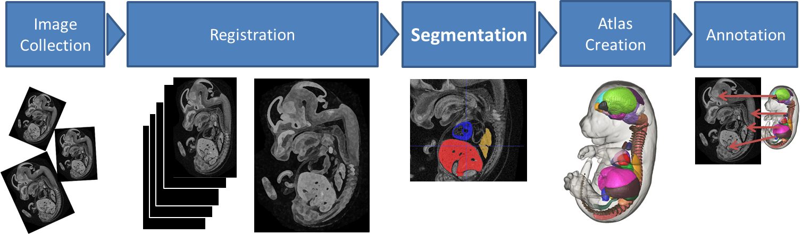
Atlas based segmentation
“A novel 3D mouse embryo atlas based on micro-CT” – Wong et al. Development 2012

Slide 10
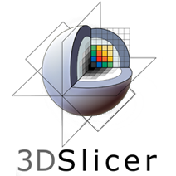
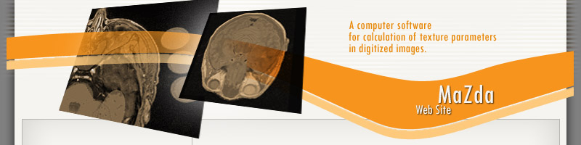

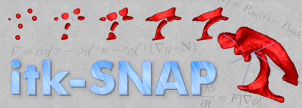

Segmentation Tools
Variety of software available
Many implement ITK and VTK open source libraries
Primarily looking at open source tools for Harwell
ITK-SNAP provides an easy to use semi-automated segmentation using a “Snake set” algorithms
3D slicer can perform Atlas based segmentation and allows development of plugins in Python.

Slide 11
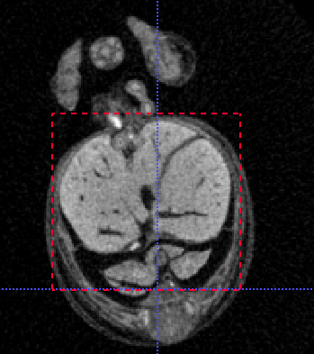
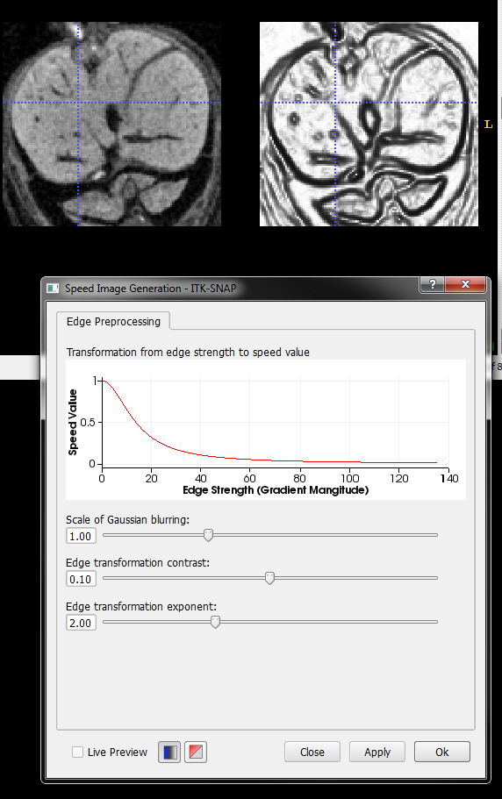
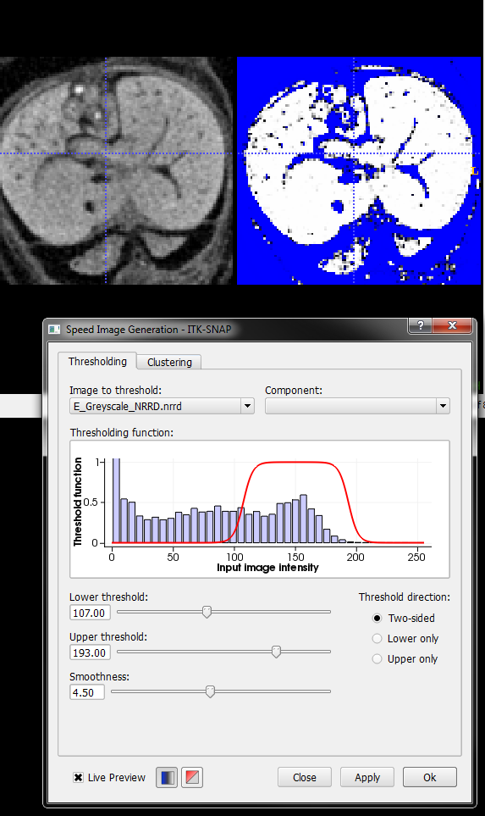
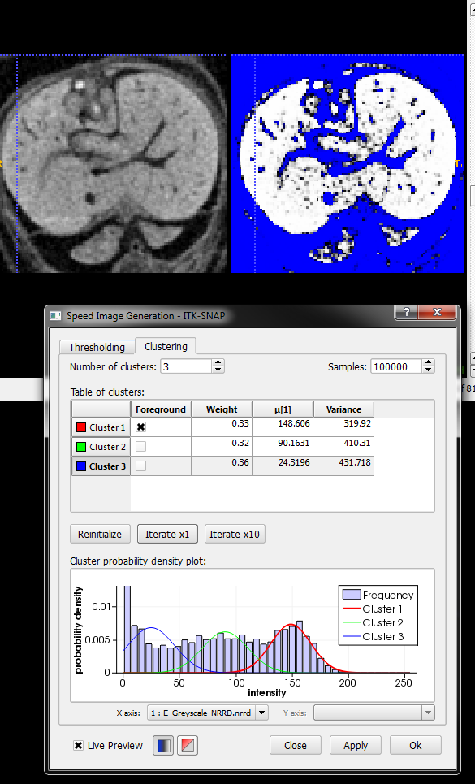
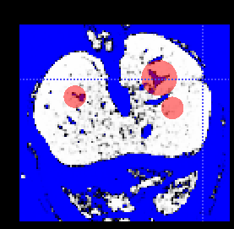
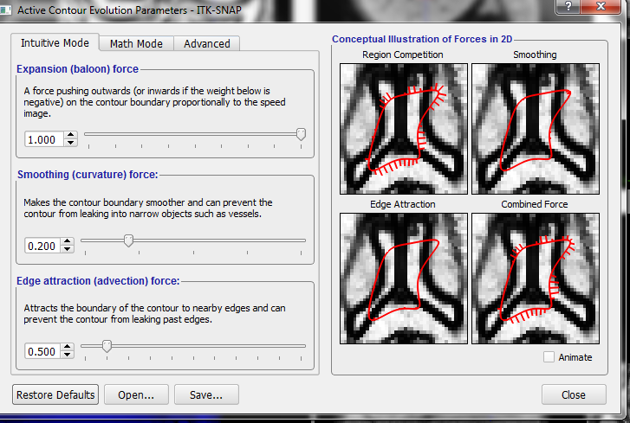
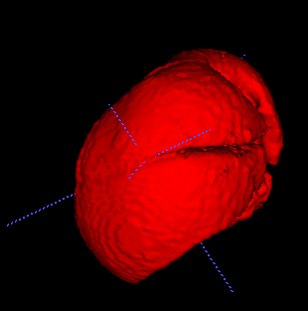
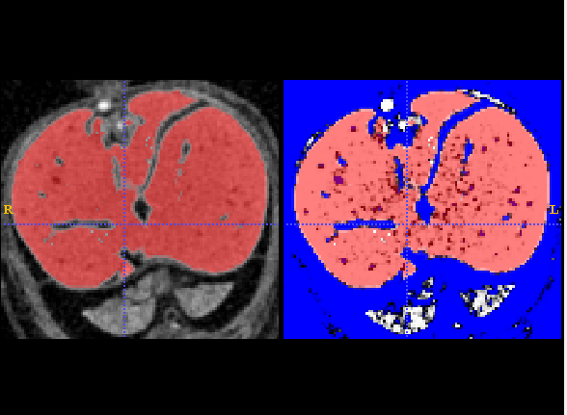
ITK-SNAP

Slide 12
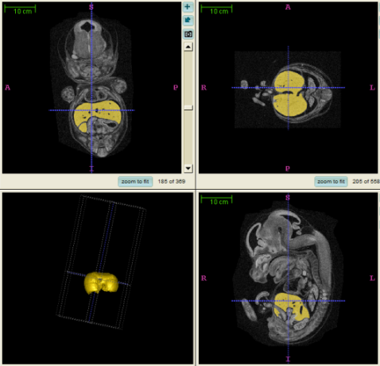
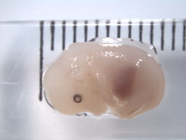
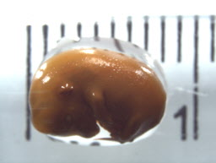
Recap on work done by Jenni, Henrik and Sara
ITK-SNAP determined as suitable tool for semi-automated segmentation
Determined how to accurately calculate volume
Showed segmentation of µCT compared favourably to MRI
Ideal preparation (image quality VS embryo shrinkage) of embryos developed for liver segmentation
50% Lugols 29 hours
100% Lugols 21 hours
100% Lugols 29 hours
Segmentation in ITK-SNAP

Slide 13
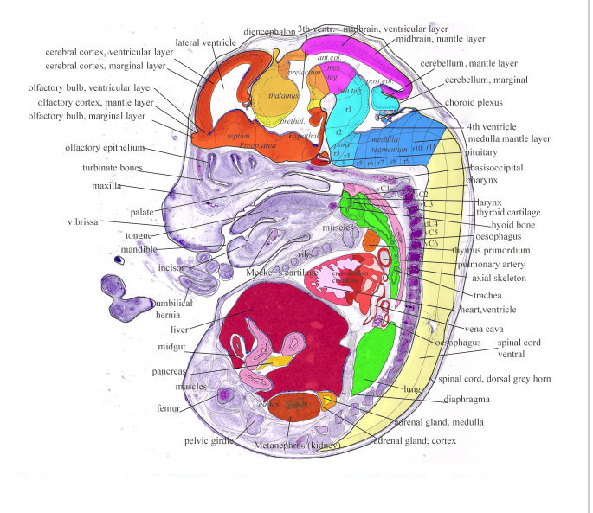
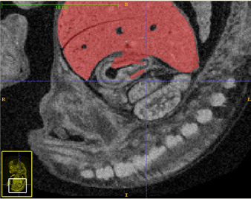
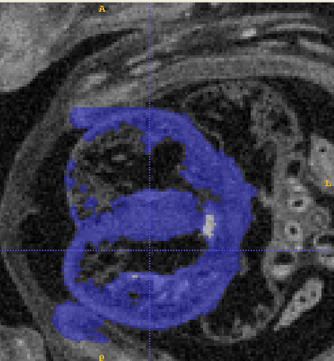
Problematic areas
When using current methods for semi-automated segmentation there will always be problematic areas where the contrast between organs is not well enough defined
All methods/tools normally have the caveat that some form of manual clean up of the image is required.
Image from Eurexpress Atlas
Segmenting from ITK-SNAP

Slide 14
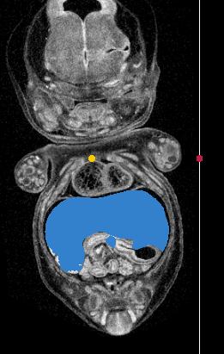
Problematic areas
Problem is not unique to ITK-SNAP
Similar problematic areas emerge when using other segmentation techniques
Robust Statistical Segmentor (3D Slicer)

Slide 15

16-bit or 8-bit grey scale?
The CT-Scan produces images from a 12-Bit camera
The reconstructed images, slices, can then be saved as either 8-Bit or 16-Bit
8 bit = 2⁸ =256 different intensities
12 bit = 2¹² = 4096 different intensities
16 bit = 2¹⁶ = 65536 different intensities
Are we missing out on subtle differences between tissues when using 8-bit?
Notes:
10
Also looking at file size

Slide 16
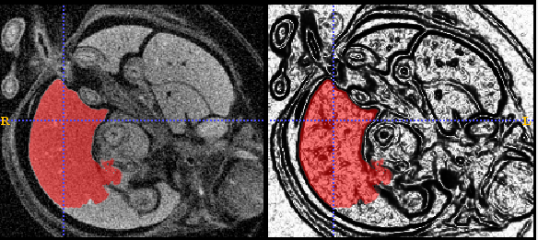
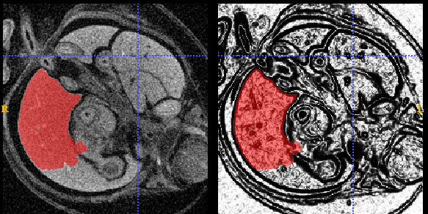
16-bit Vs 8-bit
Liver, analysed in ITK-SNAP using edge based method
16 bit
Embryo B: 177Mb
8 bit
Embryo B: 95Mb
Notes:
Embryo B

Slide 17
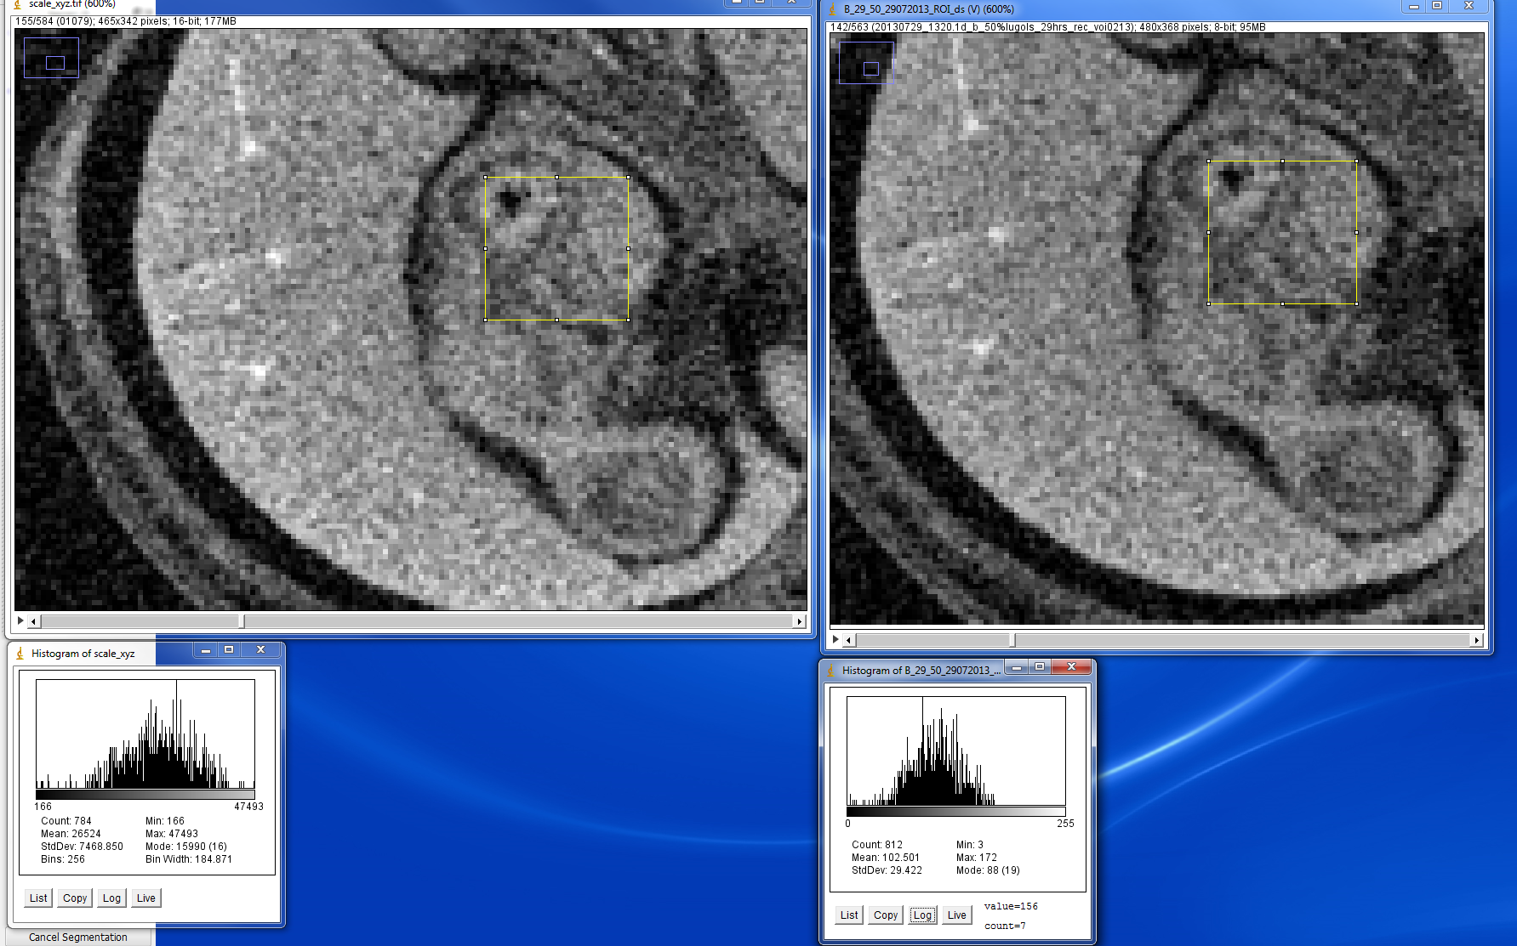
16-bit Vs 8-bit
Liver, histograms of region within rectangle
16 bit
8 bit
Embryo B

Slide 18
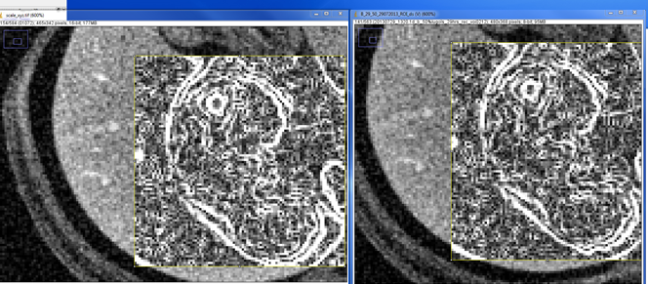
16-bit Vs 8-bit
Liver with ImageJ Edge detection
16 bit
8 bit
Embryo B

Slide 19
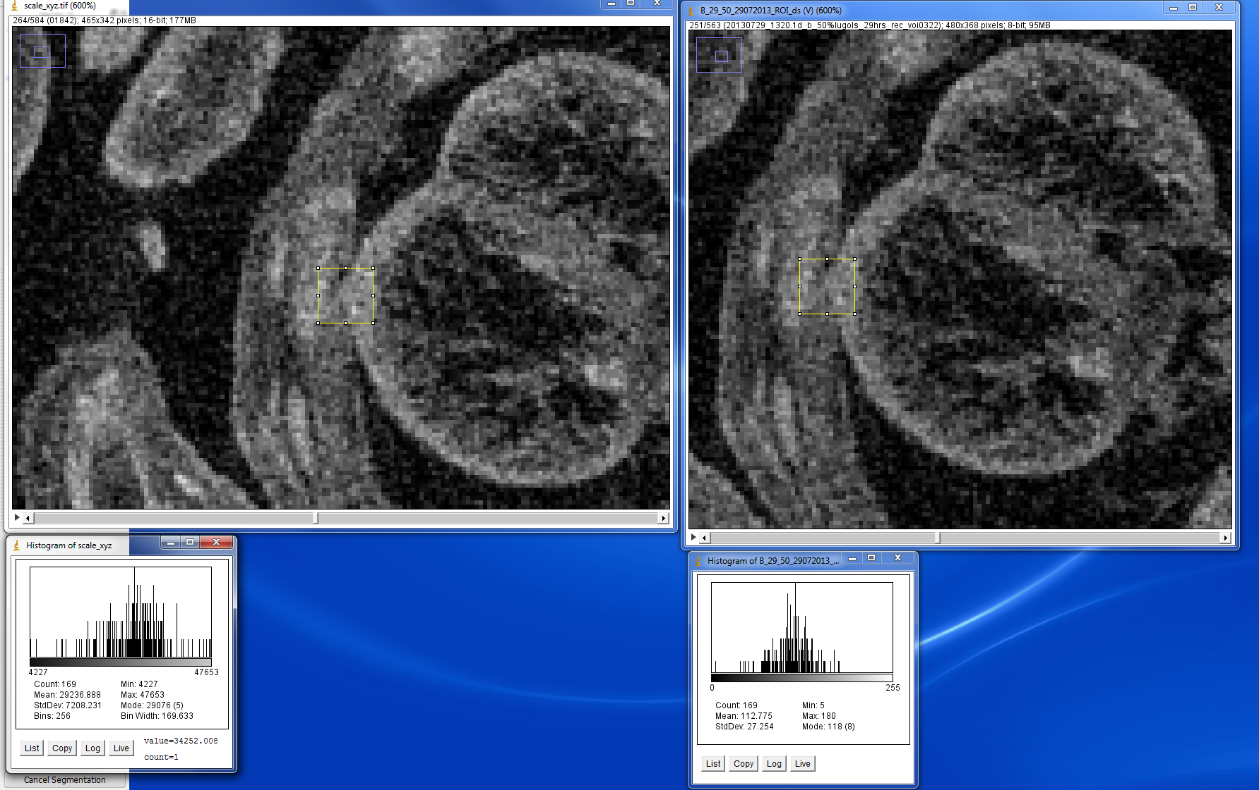
16-bit Vs 8-bit
Heart, histograms of region within rectangle
16 bit
8 bit
Embryo B

Slide 20
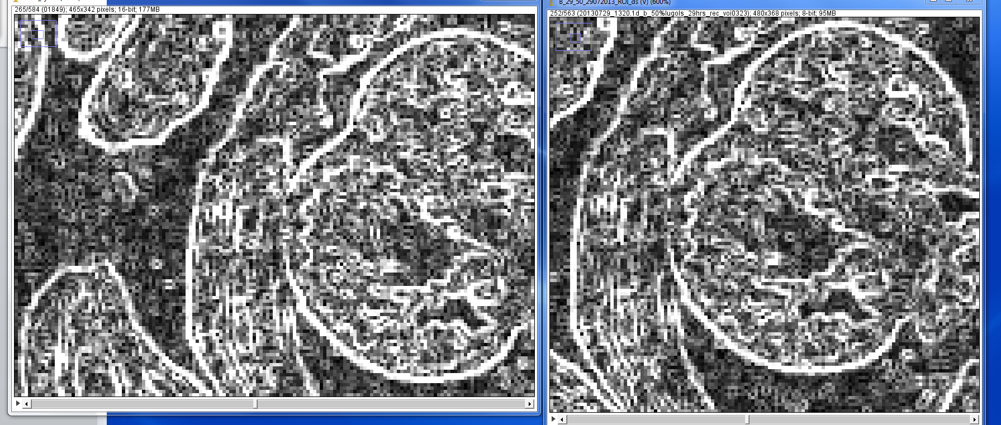
16-bit Vs 8-bit
Heart with ImageJ edge detection
16 bit
8 bit
Embryo B

Slide 21
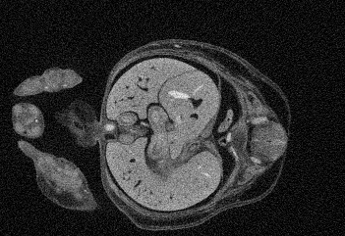

Adjust Downscaling
The reconstructed images are downscaled prior to segmenting
Information will be lost when downscaling
Does reducing the magnitude of downscaling preserve information which can help segmenting?

Slide 22
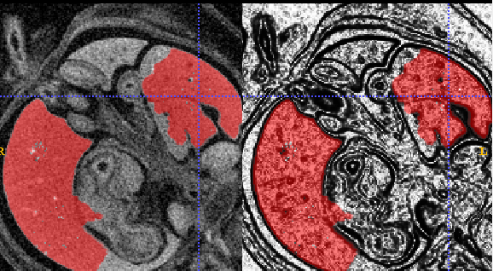
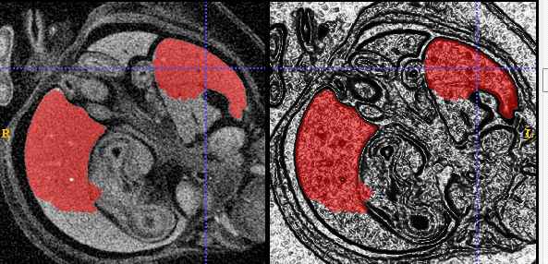
Adjust Downscaling
Downscaled by 7
(177 MB)
Downscaled by 5 (484 MB)
Not much improvement……………..
Embryo B

Slide 23
Pre-processing and “cleaning”
Pre-processing of the images to further define regions of interest prior to segmenting could help
Perform specific processing on problematic regions
Define the region of interest more dynamically
Could use VTK or ITK for this
Could develop tools for cleaning up the segmentation
This can be done with ITK-SNAP or slicer but there is room for improvement

Slide 24
Summary
16 bit and adjusting downsizing scale do not make a huge difference to segmenting the current dataset
Pre-processing and cleaning tools could be utilized or developed to help the segmentation
Other software?
Semi-automated segmentation with cleaning up will still be faster than manual!
Notes:
Pre-processing: e.g blurring certain areas

